Slide 1
AlphaFold Prediction
Bou-Nader Lab
Notes:
Hi everyone, my name is Conny. I’m a lab member working under Charles, and I’ve been closely involved with this AlphaFold prediction project for quite some time. I’m currently an undergraduate student in computer science, and I’ve been primarily responsible for building and managing the data pipeline that supports this analysis.
I’m really excited to be here today to share some of the work we’ve done. In the first part of the presentation, I’ll walk you through the approaches we took to tackle this dataset, share some key results and insights we’ve gained along the way.
Then, in the second half, Charles will take over and dive deeper into the biological implications of our findings.

Slide 2
Table of Contents
Data pipeline
2.
Choices of Prediction Models
3.
Result Tables
4.
Result Visualization
Notes:
Here is a general roadmaps, I will first talk about the bigger image, the structure of the data pipeline, and then the selection of alphafold models, explaining some of their strength and weakness, and then dive into the result analysis

Slide 3
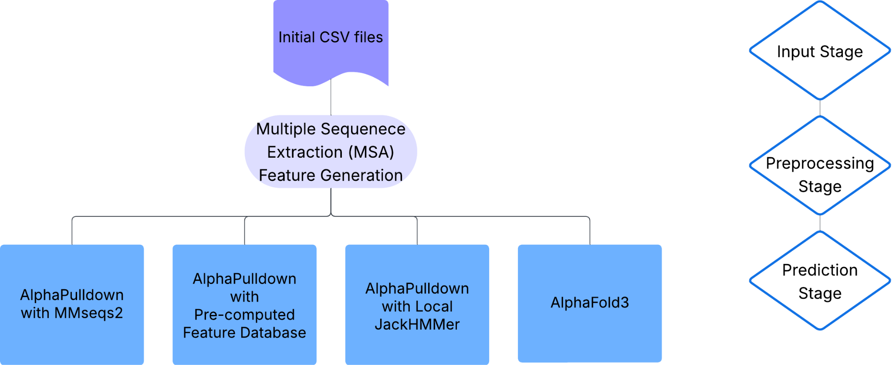
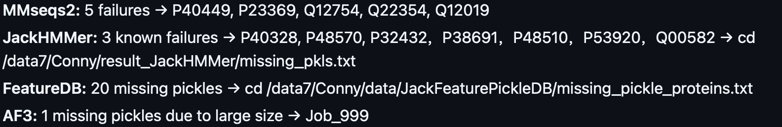
Data Pipeline
Initial CSV files: containing our bait protein and target proteins (Q04740 · RNH1_YEAST v.s. A total of 1862 unique proteins)
Preprocessing: 1. Extract amino acid sequences from Uniprot 2. Multiple Sequence Alignment (MSA) for feature pickle data generation
4 Routes:
1 .AlphaPulldown MMseqs2
2. AlphaPulldown Feature Database
3. AlphaPulldown Local JackHMMer
4. Alphafold3
Figure 1: Pipeline Flowchart
Figure 2: Reported Missing Proteins
Notes:
The input data we’re working with is a CSV file that contains a large number of protein–protein interactions. In this case, we have one bait protein and 1,862 unique target proteins.
The first step in our pipeline is data preprocessing. We begin by extracting the amino acid sequences for all these proteins, which we then pass through a process called MSA — short for Multiple Sequence Alignment.
This step helps us build evolutionary context around each protein and ultimately generates pickle files that store important features used in structure prediction.
For the prediction phase, we input these features into four different models — three of them are from AlphaPulldown, and the fourth is from AlphaFold3.
I’ll explain the differences between these models and why we used each one in the next slide.
But before that, I just want to briefly flag a small challenge we’ve run into: since we’re working with such a large dataset, we’ve encountered a few missing proteins. These are mostly due to retrieval or alignment failures. We’ve been tracking these cases carefully and plan to resolve them after the main predictions are completed.

Slide 4
Choices of Prediction Models
1. AlphaPulldown with MMseqs2
Description: Fast and lightweight MSA generation using MMseqs2.
Pros: Quick setup, suitable for large-scale screens.
Cons: May be less accurate than JackHMMer for deep MSAs.
2. AlphaPulldown with Precomputed Feature Database
Description: Uses pre-extracted MSA/structure features from a local database.
Pros: Fastest if database is comprehensive.
Cons: Limited to proteins already in the database.
3. AlphaPulldown with Local JackHMMer
Description: Generates high-quality MSAs locally using JackHMMer.
Pros: Best balance of quality and reproducibility.
Cons: Computationally intensive, needs local Uniref DB.
4. AlphaFold3
Description: Direct prediction using advanced multimer models (AF3).
Pros: State-of-the-art accuracy, can handle complex multimers.
Cons: Rate limit
Notes:
Here’s a brief overview of the models we chose to use.
First, we used AlphaPulldown, which is built on top of AlphaFold2 — a transformer-based model released by Google DeepMind back in 2021.
We also incorporated AlphaFold3, which is the current state-of-the-art. It uses a diffusion-based architecture that allows it to capture molecular interactions in a more flexible and detailed way.
At the end of the day, all of these are complex deep learning models, each with its own strengths and limitations. It’s not always straightforward to say which one is “better,” especially across different use cases.
That’s why we decided to run predictions through all four models — three from AlphaPulldown and one from AlphaFold3 — with the hope of seeing consistent trends across models.
If we don’t get perfect consistency, that’s also expected. These models can be fickle, and differences in architecture and training data can lead to variability. But even in that case, we can still use the discrepancies to cross-validate our results and gain deeper insight.

Slide 5
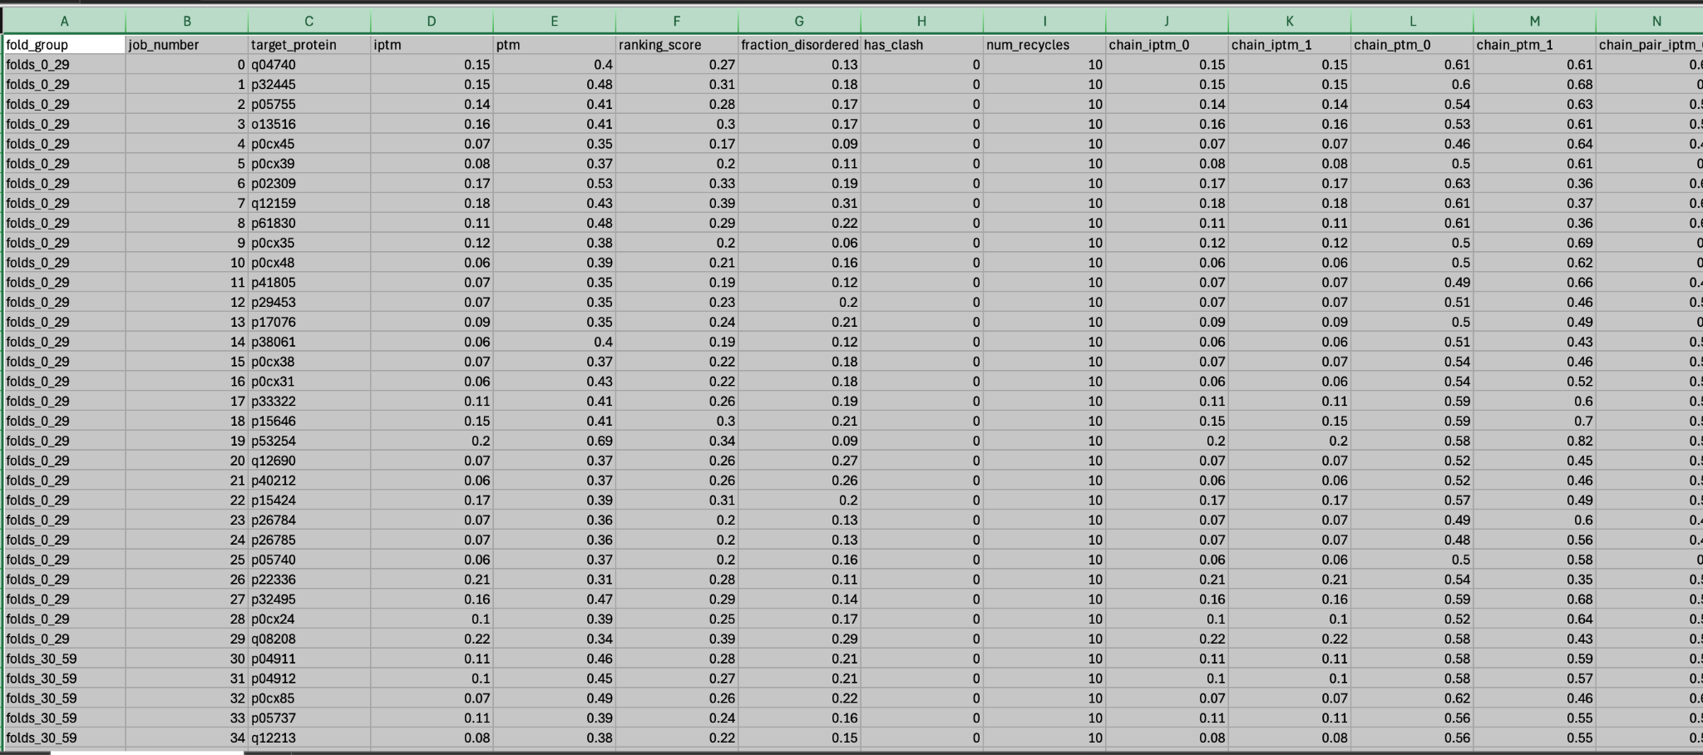
AF3 Result Table
Summary outputs:
ptm: A scalar in the range 0-1 indicating the predicted TM-score for the full structure.
iptm: A scalar in the range 0-1 indicating predicted interface TM-score (confidence in the predicted interfaces) for all interfaces in the structure.
fraction_disordered: A scalar in the range 0-1 that indicates what fraction of the prediction structure is disordered, as measured by accessible surface area.
has_clash: A boolean indicating if the structure has a significant number of clashing atoms (more than 50% of a chain, or a chain with more than 100 clashing atoms).
ranking_score: A scalar in the range [-100, 1.5] that can be used for ranking predictions, it incorporates ptm, iptm, fraction_disordered and has_clash into a single number with the following equation: 0.8 x ipTM + 0.2 x pTM + 0.5 x disorder − 100 x has_clash.
Figure 3: AF3 Result Table
Referencing
https://alphafoldserver.com/faq#how-do-i-interpret-all-the-outputs-in-the-downloaded-json-files
Notes:
Once the predictions are complete, we receive a result table that summarizes how well each protein–protein interaction was predicted.
We’ll dive into the visualizations of this result table shortly, but before that, I want to walk you through the metrics we use to evaluate prediction quality — because understanding what makes a “good” or “bad” prediction is essential to interpreting the results.
Among the many metrics available, two of the most important are pTM and ipTM.
pTM, or predicted TM-score, measures the confidence in the structure of a single protein.
ipTM, or interface predicted TM-score, evaluates the confidence in the interaction between two proteins.
These scores have been widely adopted as gold standards for prediction quality since their introduction.
In addition to pTM and ipTM, we also look at a few other supporting metrics:
Fraction disordered, which tells us how much of the protein might be structurally unstable or flexible,
And a boolean flag called has_clash, which indicates whether the predicted structure has any atomic overlaps that would be physically implausible.
Together, these are often combined into a composite metric known as the ranking_score, which helps us systematically rank and filter the predictions for further analysis.

Slide 6
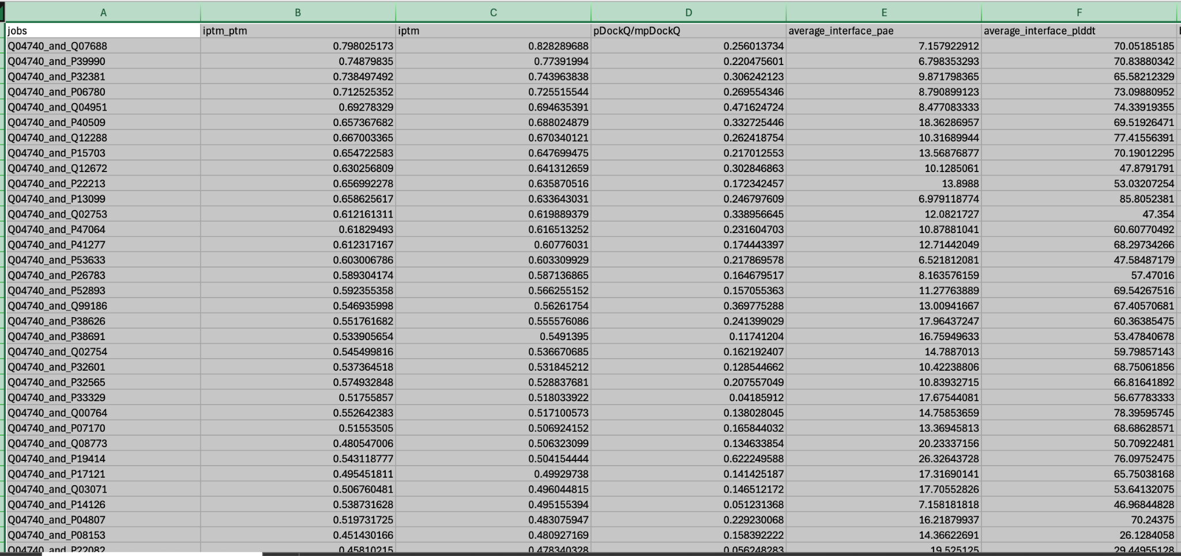
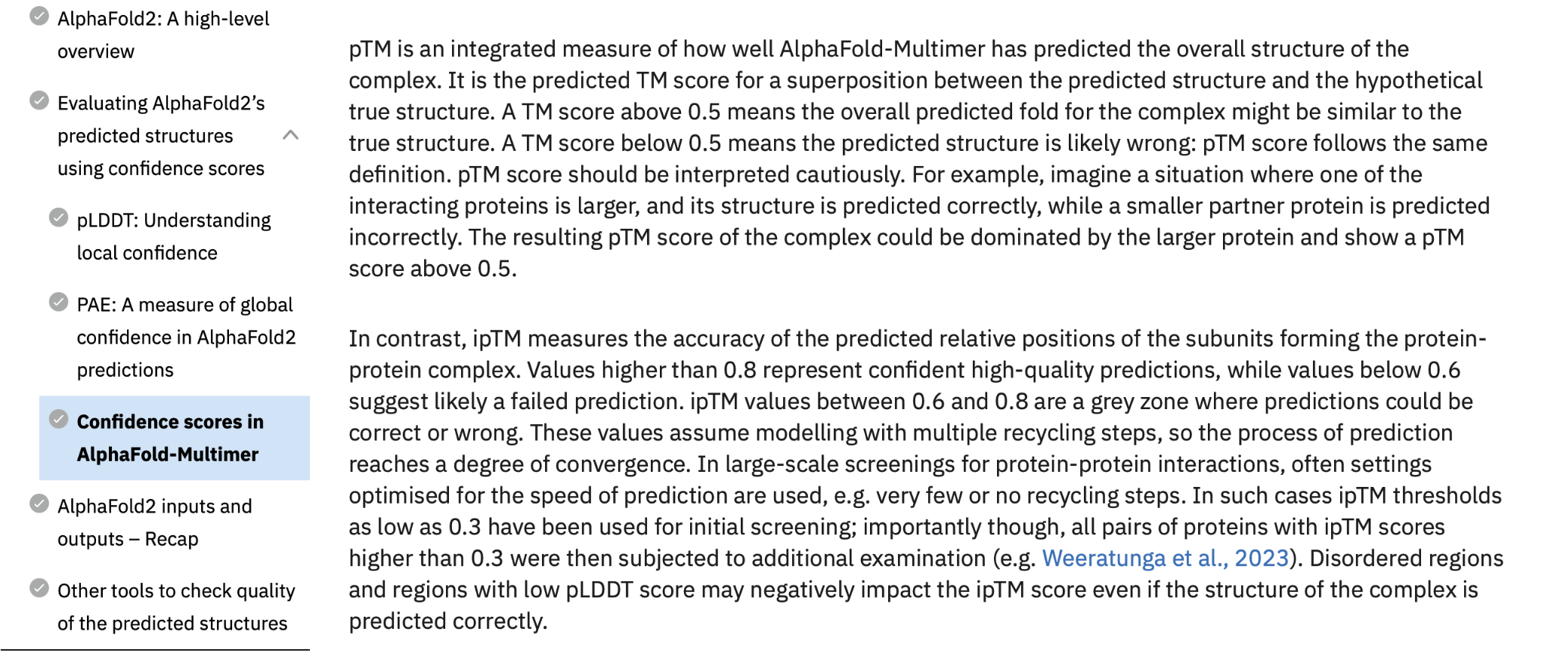
AFP Result Table
Summary outputs:
iptm: A scalar in the range 0-1 indicating predicted interface TM-score (confidence in the predicted interfaces) for all interfaces in the structure.
Iptm_ptm: A composite score combining iptm and ptm = 0.8*iptm + 0.2*ptm
Filtering Standard:
(af3_data['iptm'] >= 0.6) & (af3_data['ptm'] >= 0.5)
(afp_data['iptm_ptm'] >= 0.5) & (afp_data['iptm'] >= 0.6)
*Note that ptm isn’t directly given in AFP, and it can be derived to choose iptm_ptm >= 0.58. We choose >= 0.5 to allow more proteins to be selected
Figure 4: AFP Result Table
Figure 5: Cutoff Threshold
Referencing:
https://www.ebi.ac.uk/training/online/courses/alphafold/inputs-and-outputs/evaluating-alphafolds-predicted-structures-using-confidence-scores/confidence-scores-in-alphafold-multimer/

Slide 7
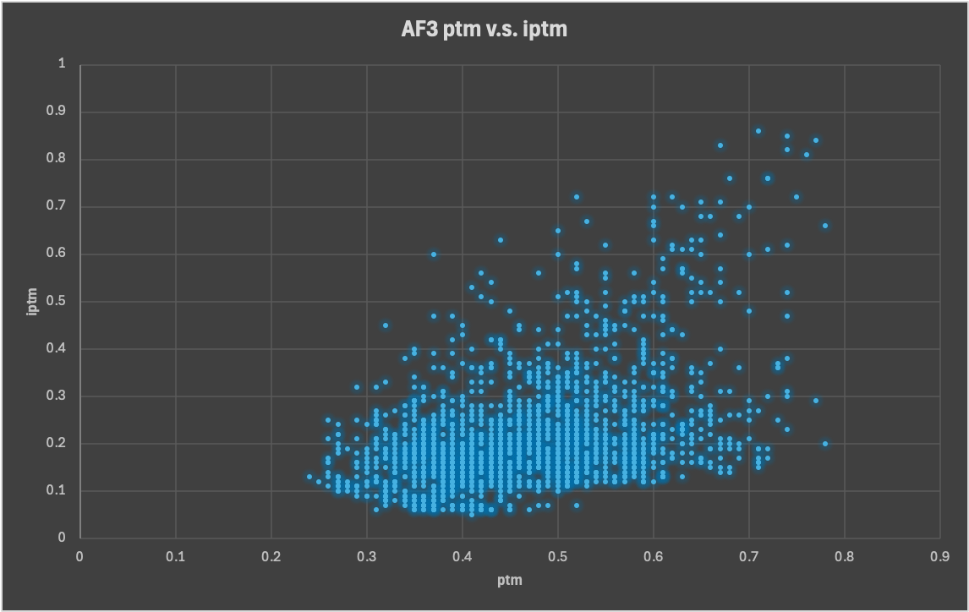
AF3 Visualization
(af3_data['iptm'] >= 0.6) & (af3_data['ptm'] >= 0.5)

Slide 8
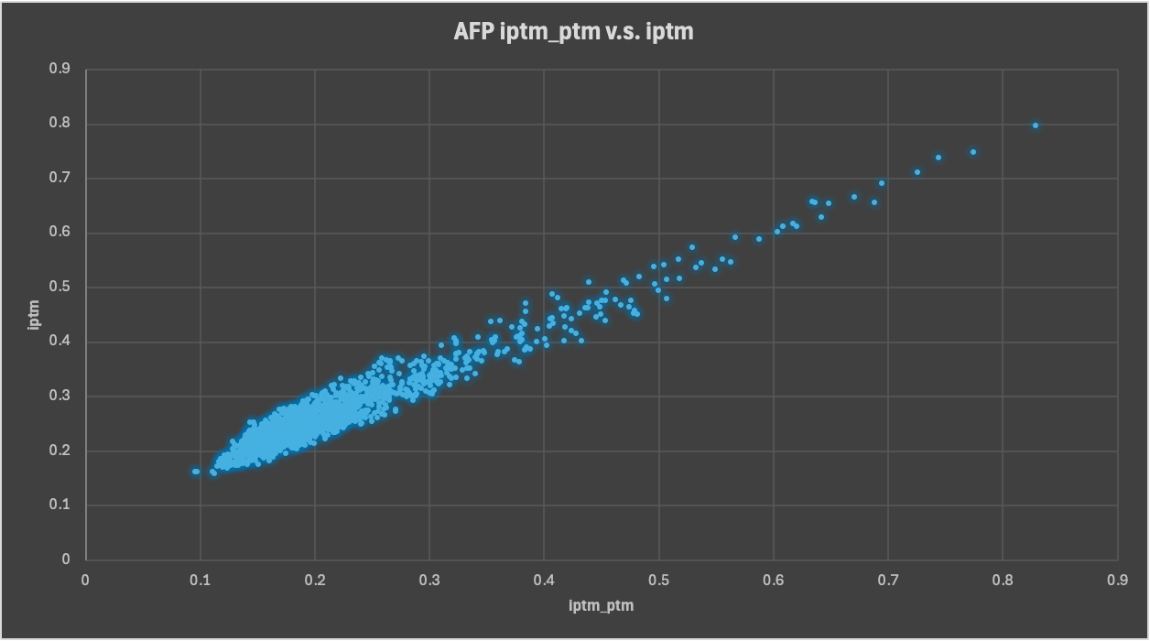
AFP Visualization
(afp_data['iptm_ptm'] >= 0.5) & (afp_data['iptm'] >= 0.6)

Slide 9
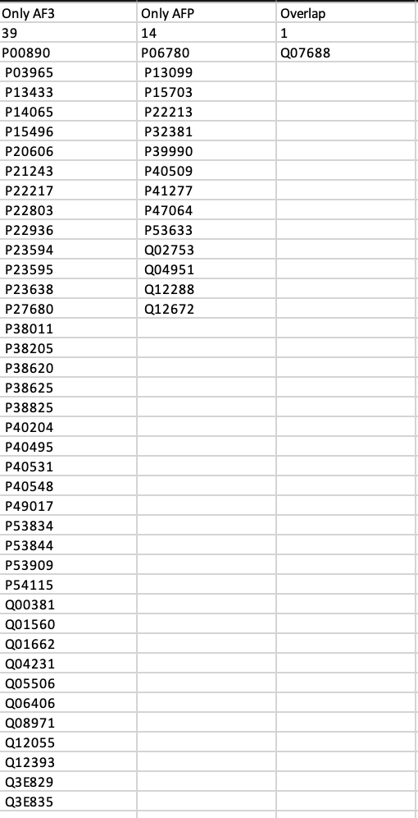
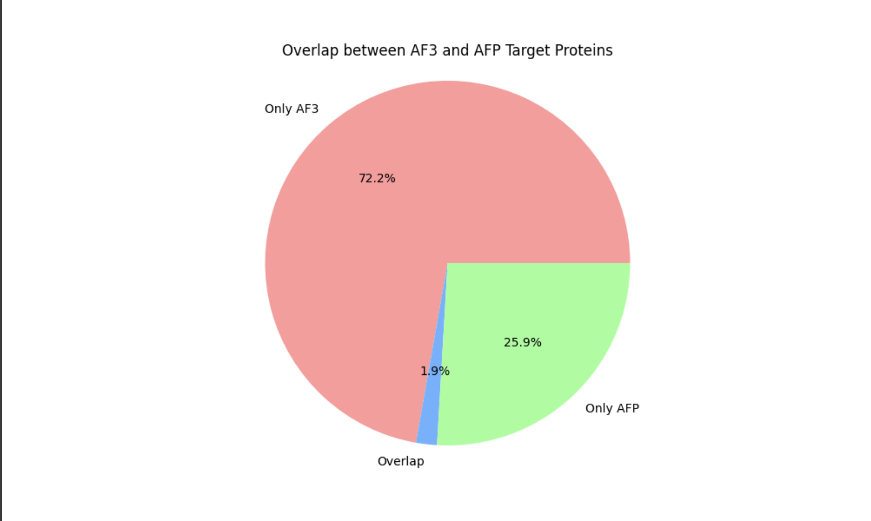
AFP Visualization

Slide 10
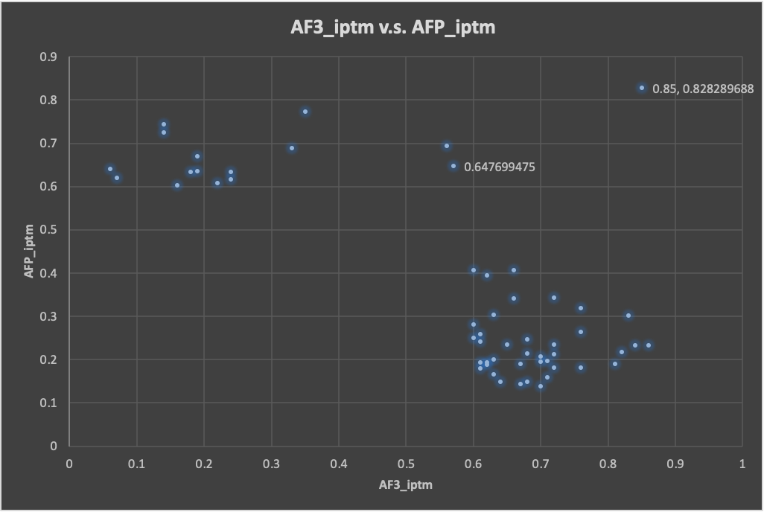
AFP v.s. AF3 Visualization
Notes:
Witnessing so little overlapping is something quite surprising, we were hoping that the 2 predictions would give similar results. So this leads us to plotting this graph. Basically for those top hits that we have seen in the last graph, what are their iptm performance in the perspective of the other model. So for instance, from the last page, protein P00890 is seen as a likely interaction according to AF3, what is its iptm in AFP. So here is the graph. We see an almost negative correlation here, where AFP predicts high, AF3 predicts low, except for the overlapped ones on the top right. Something worth thinking of, and we have indeed seen this type of prediction in literature. So here concludes my report, Charles will have the stage and present some of the manual observation.

